Slide 2
Update, Poll, Q&A: John Jacobs, Moderator
Panelist Introductions
Panelist Insights and Discussion
Poll Results
Audience Q&A Session

Slide 3
Quick Update as of 8/6/20
Top-line Statistics
PPP loan deadline extended from 6/30/20 to 8/8/20, 2 Days remaining
$130B remains in fund as of 7/31 (SBA)
New tool to submit loan forgiveness, pppforgivenesstool.com (created by AICPA)
Congress is negotiating a possible extension to YE2020
Unemployment filings week-ending 7/25: 1.2M Filings (US Dept. of Labor, 8/6)
Unemployment rate dropped in June to 11.14%, 11.1% as of 7/18
$600 per week unemployment supplement has ended
Congress back in full session on September 8th
Q2 GDP contracted by (32.9%) annualized (US Dept. of Commerce, BEA)
Q3 forecasted GDP 20.3% annualized expansion (Federal Reserve of Atlanta, 8/5)
Total Coronavirus Cases as of 8/6 (Johns Hopkins University, Coronavirus Resource Center)
Worldwide Cases: 18.8M (increase of 3.6M over last two weeks)
US Cases: 4.8M (increase of 830K over last two weeks)
US Deaths: 158,300 (increase of 15,096 over last two weeks)
Remote workers expected to permanently rise to 25%-30% by YE 2021, from 3.6% in 2019
Verizon saw a 1,200% rise in collaboration tool usage and 81% increase in VPN usage since the start of the Covid-19 Pandemic

Slide 4
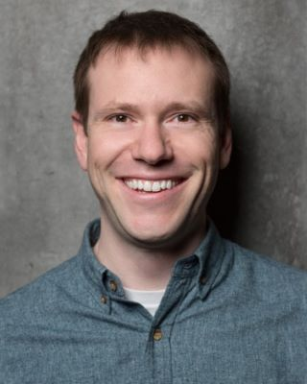
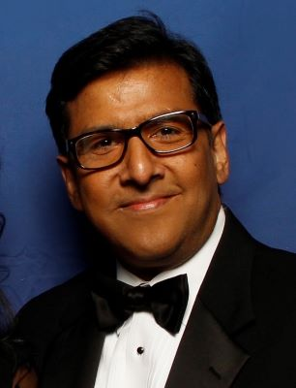
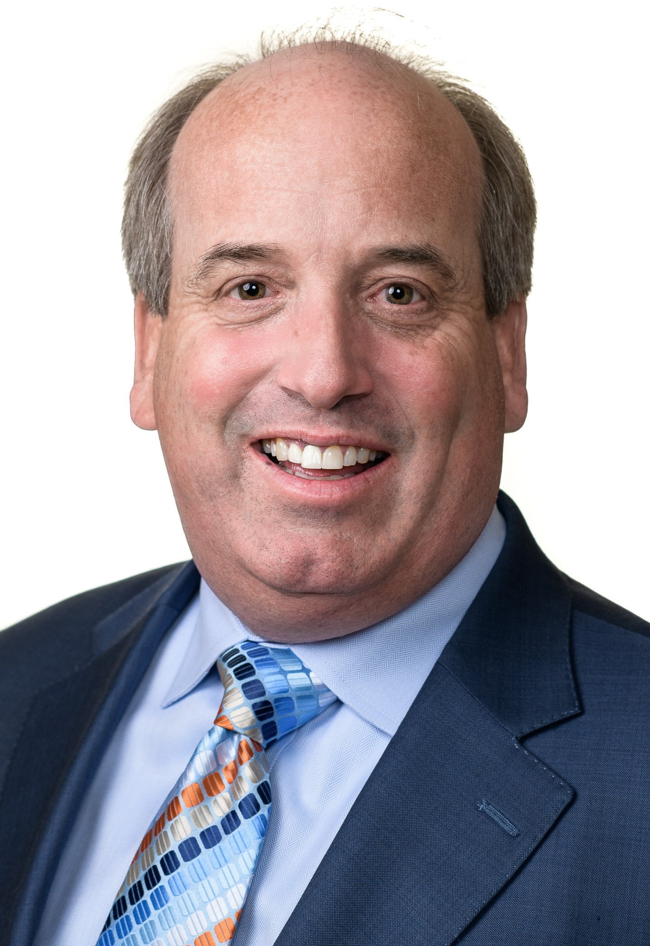
Today’s Panelists
Mark Flynn
Research Lead
Communications & Media Research
Accenture
Jai Saboo
Chief Operating Officer
Harmonia Holdings Group, LLC
Sean Sullivan
Regional Sales Director,
Mid-Atlantic, Commercial Market
Dell Technologies

Slide 5
Poll Results, Questions and Answer Session
(Please click Q&A tab at bottom or top of screen to ask a question)

Slide 6
Next webinar:
Thursday, August 20th, 2pm ET
“Growth Funding”

Slide 7
You can find our webinars at:
www.novaeda.org (under “Events”)
Beyond Covid-19: Business Survival Toolkit
Beyond Covid-19: Funding and Financing In-depth
Beyond Covid-19: What’s best for my business, what’s best for my people?
Beyond Covid-19: Keeping my customers and finding new ones in this climate
Beyond Covid-19: New Business Models, how to ensure resiliency in your business
Beyond Covid-19: Marketing and Business Development in a New Age
Beyond Covid-19: Supply Chain Management in a New Age
Beyond Covid-19: The New Normal: Getting Back to Work Safely

Slide 8
Thank you.

