Slide 1
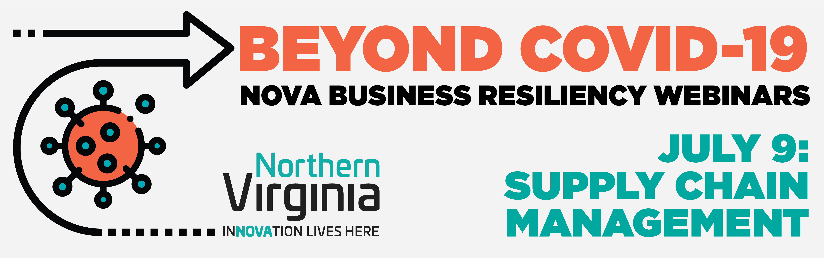

Slide 2
Welcome remarks: Michele Weatherly
Department of Economic Development, Prince William County, VA
Update, Poll, Q&A: John Jacobs, Moderator
Panelist Introductions
Panelist Insights and Discussions
Poll Results
Audience Q&A Session

Slide 3
Quick Update as of 7/9/20
Top-line Statistics
PPP loan deadline extended from 6/30/20 to 8/8/20, $130B remains available
  Loan rules loosened in June by Congress and Administration, e.g. 24-week repayment vs. 8-week repayment, 60% usage for payroll vs. 75%
Unemployment filings week-ending 7/4: 1.3M Filings (US Dept. of Labor, 7/9)
  Unemployment dropped in June to 11.14% from an April high of 14.7%
  $600 per week unemployment supplement ends by 7/31
  Pending legislation to be debated such as the Heroes Act, Workers Relief and Security Act
US economy shrank by (4.8%) during Q1 2020 (U.S. Dept. of Commerce)
  Q2 Updated forecast (35.2%) drop as of 7/2/20 (Federal Reserve Bank of Atlanta)
Total Coronavirus Cases as of 7/9 (Johns Hopkins University, Coronavirus Resource Center)
  Worldwide Cases: 12M (increase of 3.6M over last three weeks)
  US Cases: 3M (increase of 840K over last three weeks)
  US Deaths: 132,309 (increase of 14,592 over last three weeks)
Consumer Confidence Index rose again June (98.1 vs 85.9 May) (The Conference Board)

Slide 4
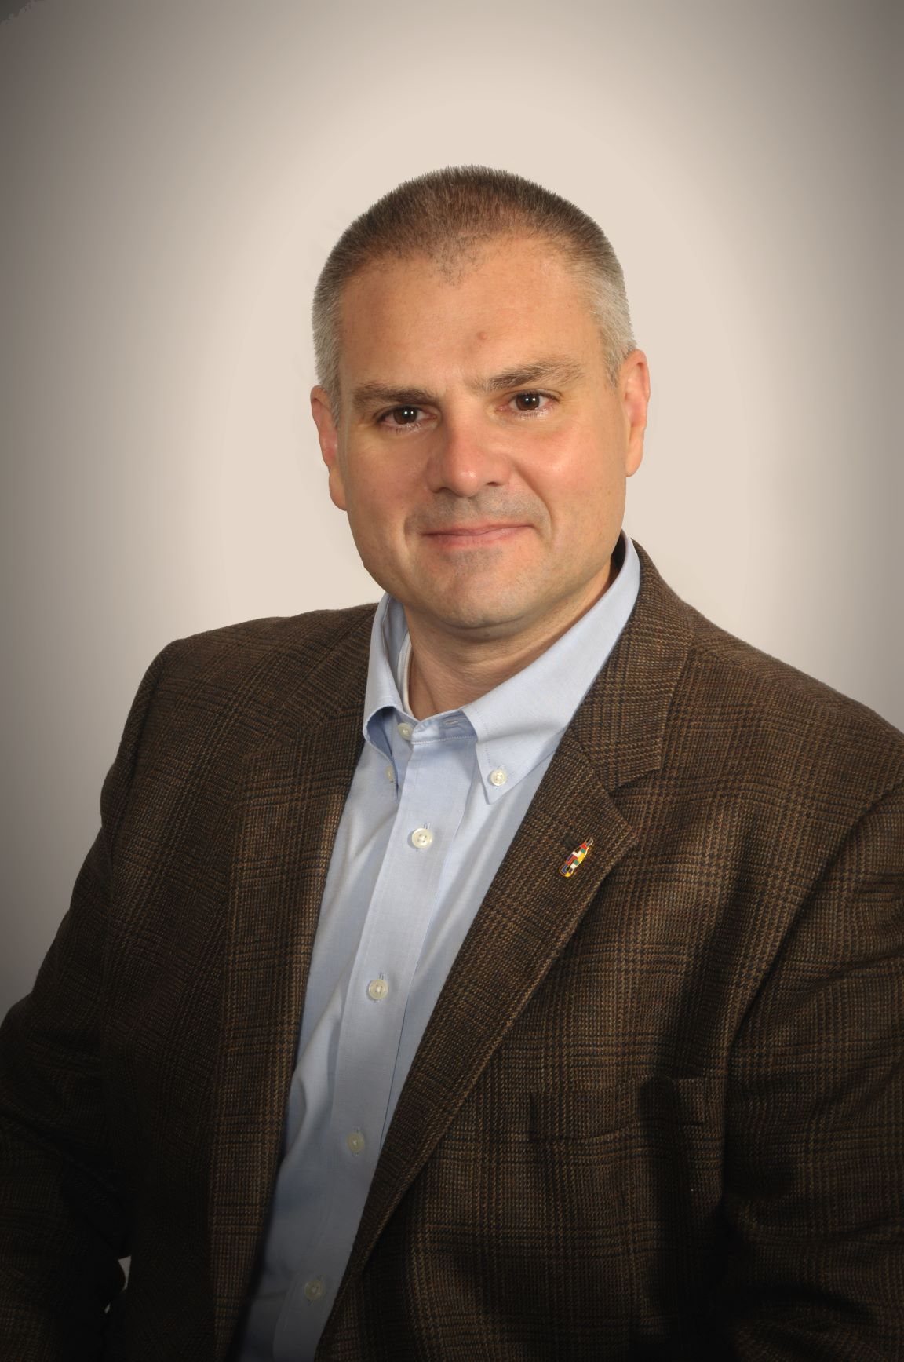
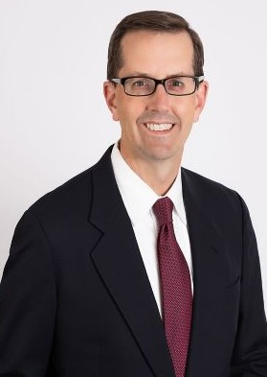
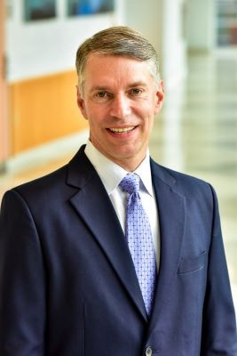
Today’s Panelists
Mike Wasson
Chair-elect
Association of Supply Chain
Management (ASCM),
Chief Operations Officer
Tosca, Ltd.
Tim Brightbill
Partner
Wiley Rein
Ron Drozd
Assistant Professor
Fox School of Business
Temple University

Slide 5
Making an Impact:
Association for Supply Chain Management
May 2020

Slide 6




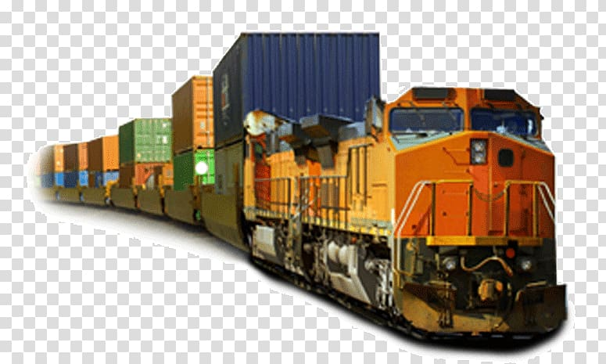
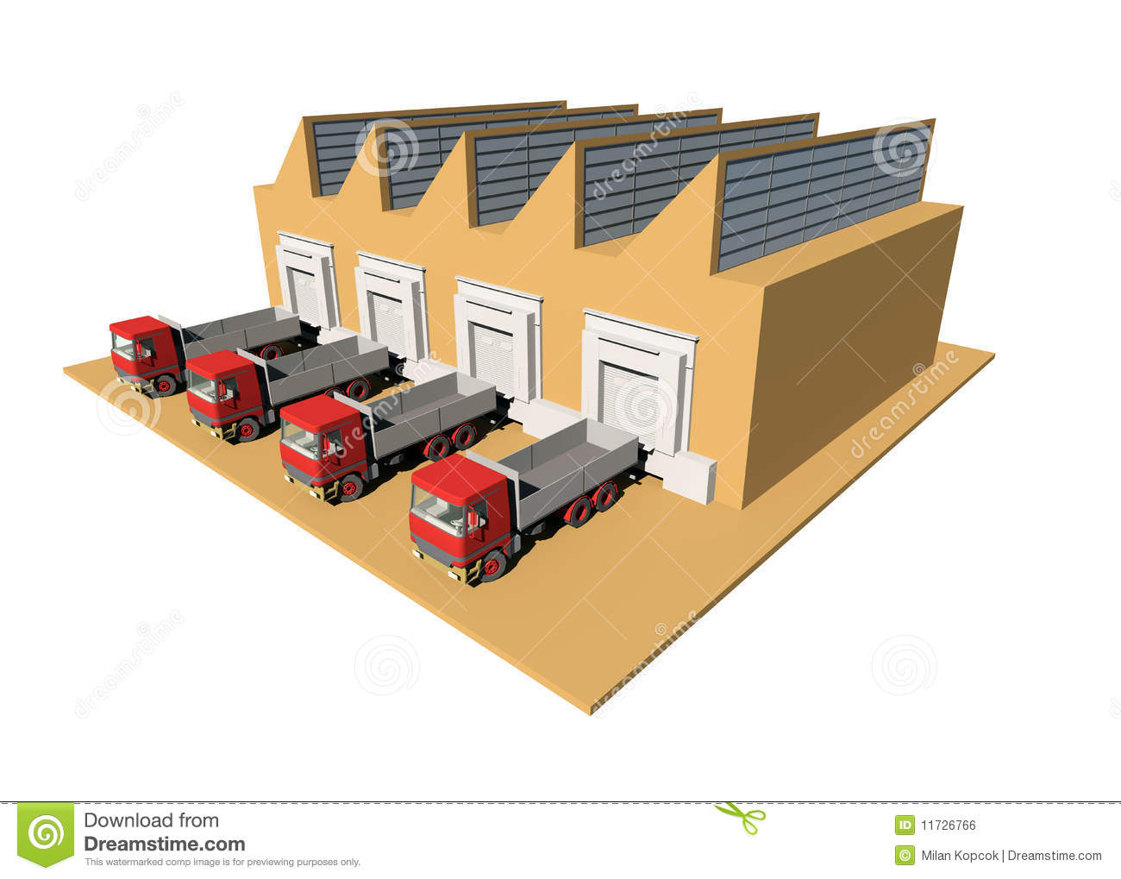
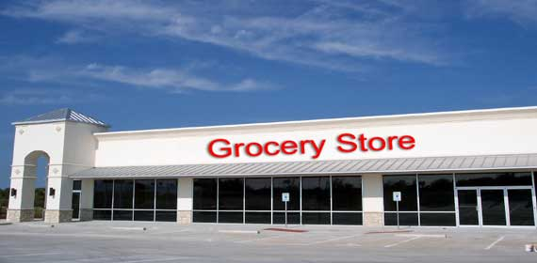


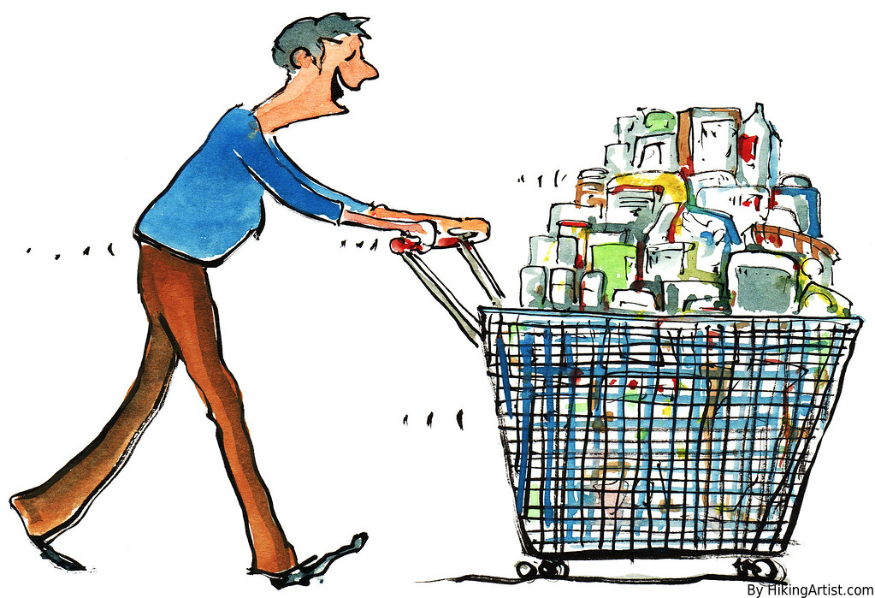
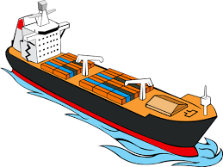

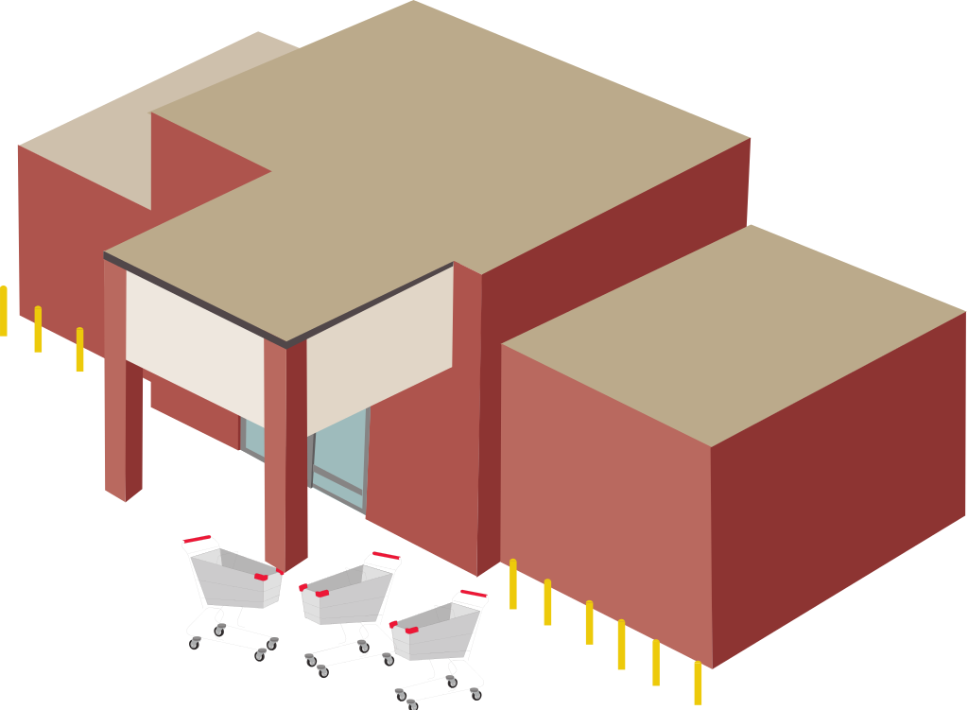







What is supply chain?
Plan
Source
Make
Deliver
Return
Enable

Slide 7
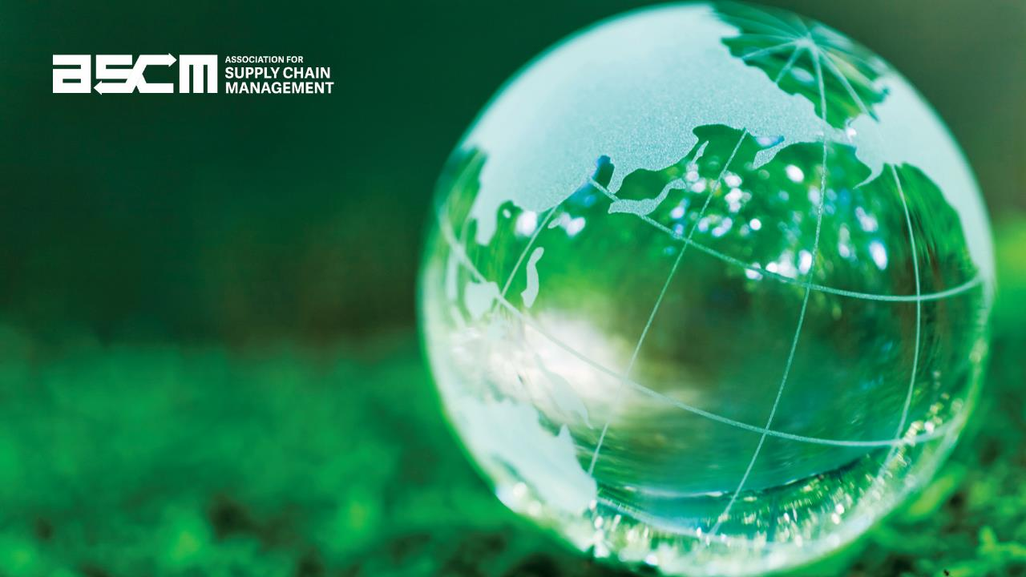
A Better World Through Supply Chain
Supply chains shape the world we live in, with economic, environmental, social, and ethical stakes for every person and place on Earth. As supply chains become more technologically advanced, complicated, interconnected, and global, these stakes only grow. ASCM sees the extraordinary mission potential of this moment. If we can mobilize global supply chain communities, extraordinary leaders and visionary partners, we can bring prosperity and opportunity to more people and places and solve critical problems that affect countless lives.

Slide 8

The Impact of the Global Supply Chain
The awareness and importance of global supply chain has never been greater. It is our collective responsibility to evolve, grow and remain on the forefront of change within the environment
Dynamic Forces Challenge the Work of the Supply Chain Professional Every Day
  Coronavirus, diseases
  Tariffs and geopolitical
  Cyber security
  Earthquakes, hurricanes and natural disasters
  Environmental and climate concerns
  Child labor

Slide 9
Efforts to Bring Supply Chains Back to the United States
New COVID-Related Efforts to Onshore Key Industries
Tim Brightbill, Wiley Rein LLP
tbrightbill@wiley.law
202-468-2823

Slide 10
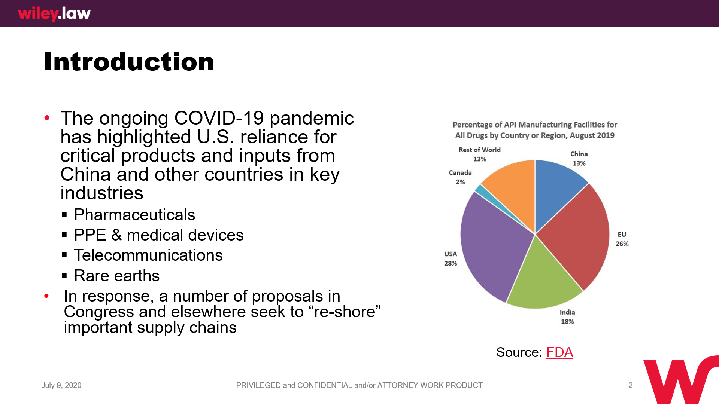

Slide 11
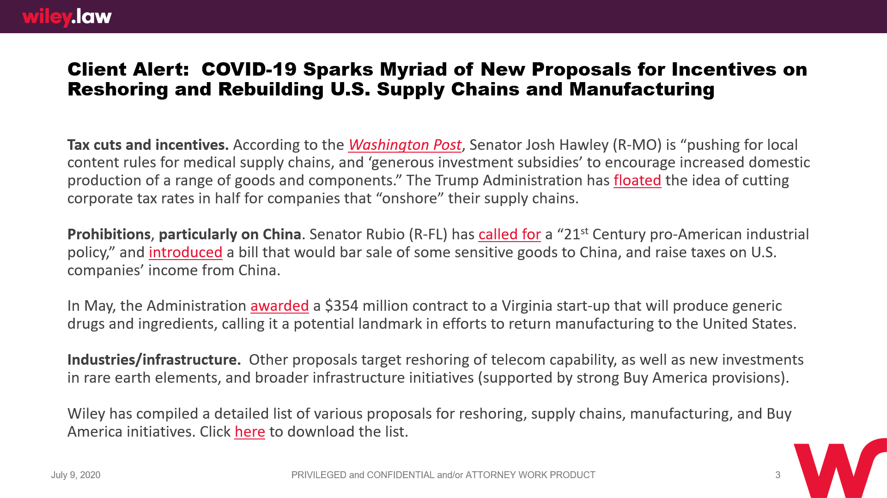

Slide 12
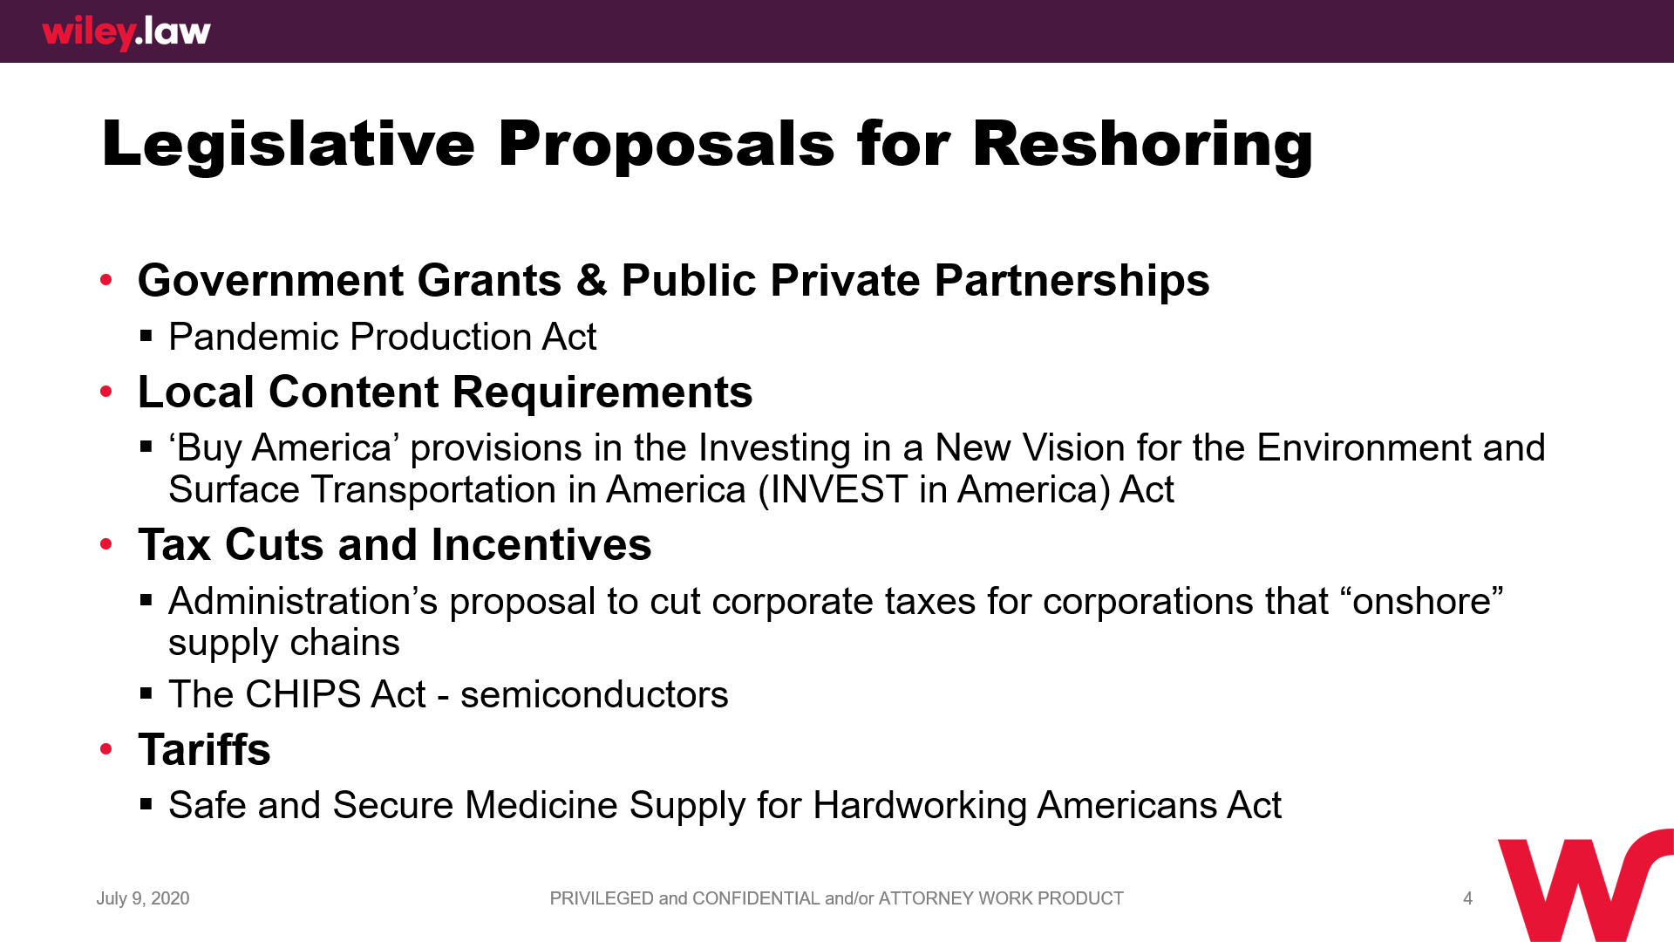

Slide 13
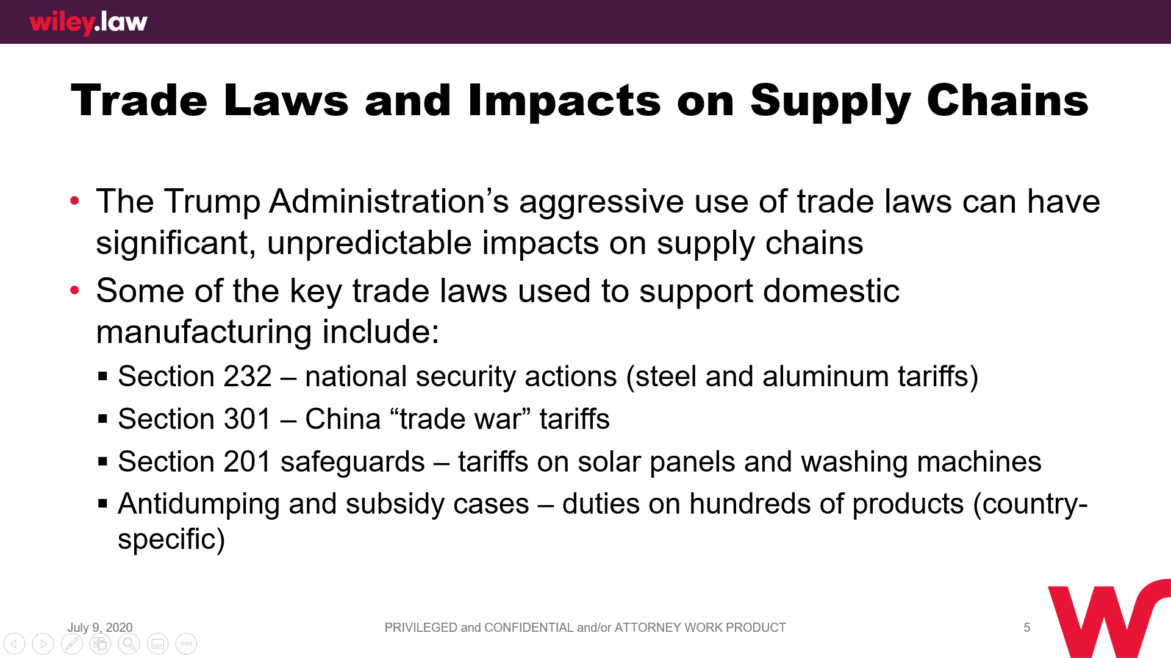

Slide 14
Poll Results, Questions and Answer Session
(Please click Q&A tab at bottom or top of screen to ask a question)

Slide 15
Next webinar:
Thursday, July 23th, 2pm ET
“The New Normal”

Slide 16
You can find our webinars at:
www.novaeda.org (under “Events”)
Beyond Covid-19: Business Survival Toolkit
Beyond Covid-19: Funding and Financing In-depth
Beyond Covid-19: What’s best for my business, what’s best for my people?
Beyond Covid-19: Keeping my customers and finding new
ones in this climate
Beyond Covid-19: New Business Models, how to ensure resiliency in your business
Beyond Covid-19: Marketing and Business Development in a New Age
Beyond Covid-19: Supply Chain Management in a New Age

Slide 17
Thank you.

